Slide 1
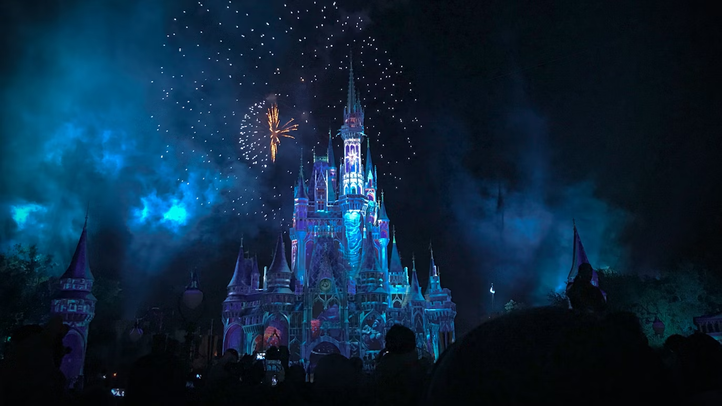

Disney villain rebellion
Dr. Kristin Bassett DNP, RN, CNE, EBP-C & Dr. Tara Grier DNP, RN, CNE

Slide 2
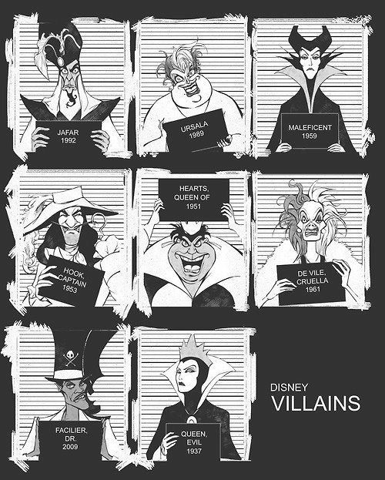
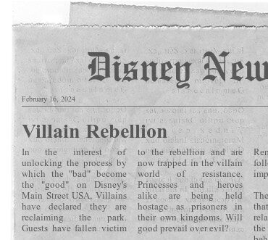
Notes:
What began as a fun company trip to Disney World, has quickly turned into a nightmare. The villains have rebelled, taking control of the park. They have locked the gates to all exits, imprisoning all who remain inside.

Slide 3

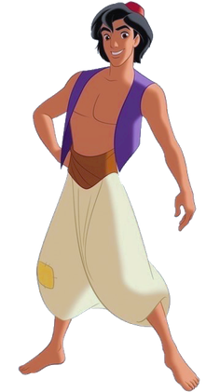
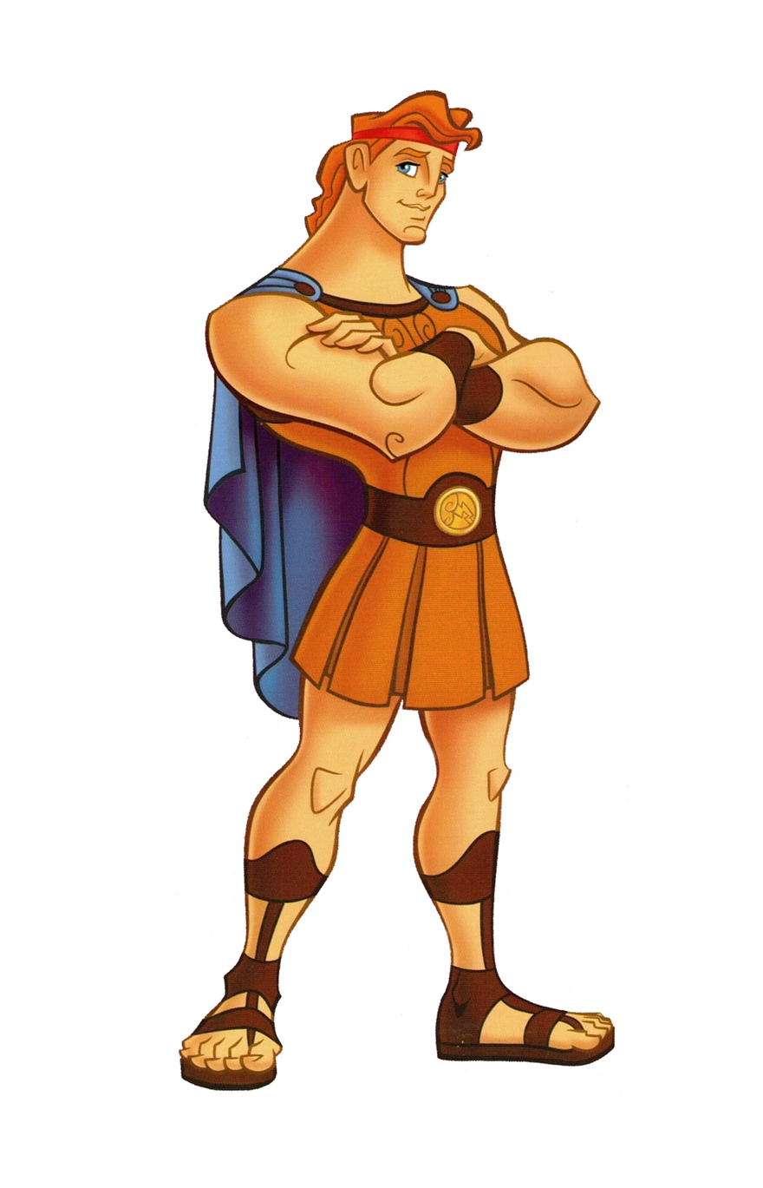


Notes:
Five characters are held captive inside their kingdom. Each possesses one piece of the map that will lead you to the gate key needed to escape.

Slide 4
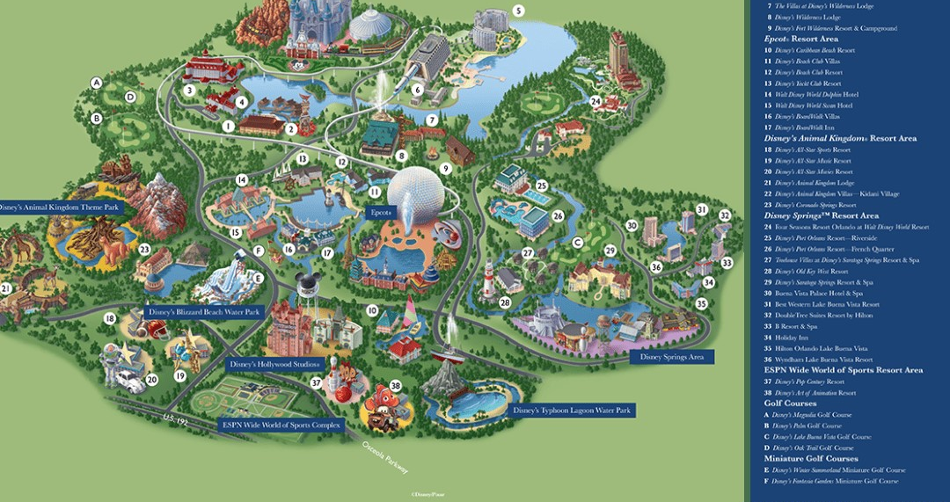
Notes:
Your team will have 25 minutes to collect each piece of the map, locate the key, and unlock the gate.

Slide 5

Notes:
It will not be easy, but they are all depending on you.

Slide 6
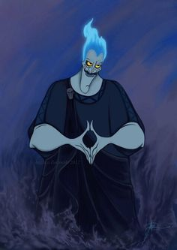

YOUR TIME STARTS NOW!
Notes:
Your time starts now!

Slide 7

Congratulations!
You Escaped!

Slide 8
Interactive Learning Strategies in the Classroom: Nursing Escape Room
Dr. Kristin Bassett, DNP, RN, CNE, EBP-C & Dr. Tara Grier DNP, RN, CNE
Indiana University Fort Wayne, School of Nursing

Slide 9
Background & Problem
Communication and collaboration are critical in many professions
Diverse levels of experience and preferred learning styles create challenges for faculty to meet each student’s needs
(Scott et al., 2023)

Slide 10
Purpose
Interactive activities
    Recognize multiple learning styles
    Allow students with various strengths and weaknesses to participate
Escape rooms incorporate a variety of learner engagement strategies
  Interactivity
  Movement to enhance focus
  Group problem-solving and cooperative learning
  Inquiry-based/problem-based learning
  Technology
  Simulation and storytelling
(McEnroe-Petite & Farris, 2019)
(Ghasemi et al., 2020).

Slide 11
Implications
Can be used at all levels of education and multiple settings
Fosters learning
Measures the application of concepts
Encourages critical thinking
Promotes teamwork and collaboration

Slide 12
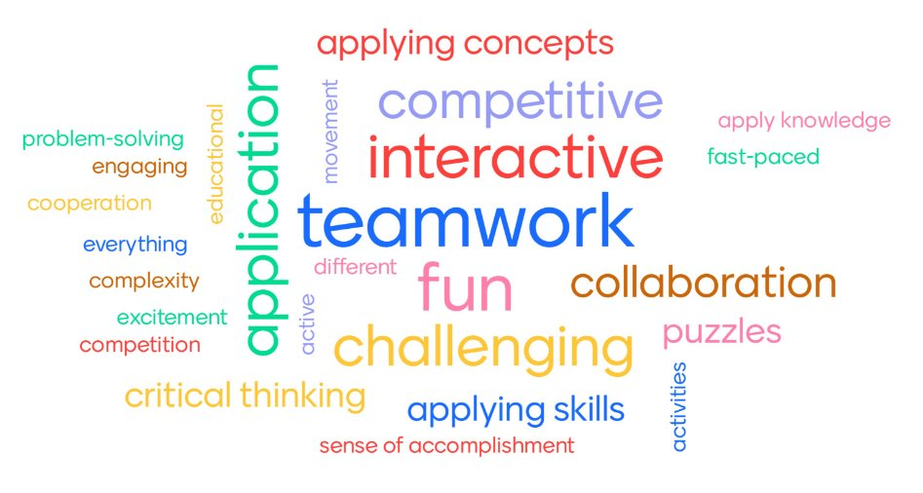
Student Feedback
Notes:
Students’ survey responses indicate this activity is a valuable learning tool to reinforce content from lectures. They felt engaged, and they enjoyed the competition aspect.

Slide 13
References
Ghasemi, M. R., Monaghan, H. K., & Heydari, A. (2020). Strategies for sustaining and enhancing nursing students' engagement in academic and clinical settings: A narrative review. Korean Journal of Medical Education, 32(2), 103–117. ​
McEnroe-Pettite, D., & Farris, C. (2019). Using gaming as an active teaching strategy in nursing education. Teaching and Learning in Nursing, 15(1), 61-65. https://doi.org/10.1016/j.teln.2019.09.002 ​
Scott, G., Bowers, T., Gibbs, S. P., Creed, J. M., Pate, L. B. (2023). Ready. Set. Game: Using nursing knowledge to escape the virtual room in the didactic setting. Nursing Education Perspectives. https://doi.org/10.1097/01.NEP.0000000000001162

